Slide 1

Ryan Chevarria, Nanae Itoi, Tahsin Provath, Kelly Camacho, Joyce Zhang

Slide 2

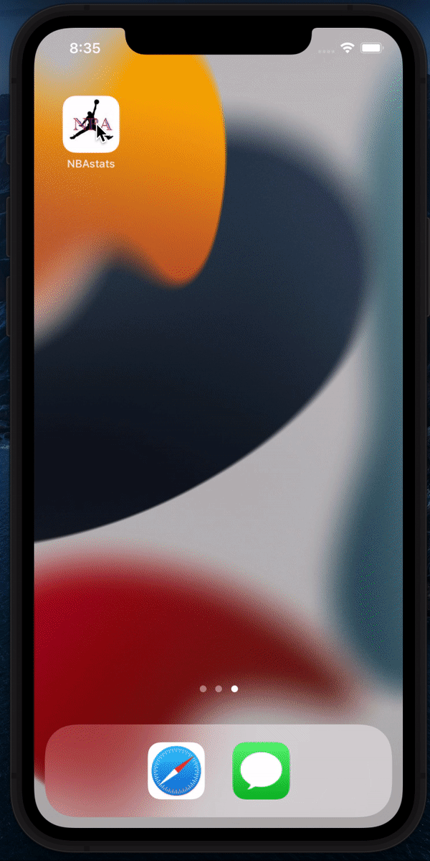
- A Basketball Stats App
NBA Stats is a basketball sports app that allow users to view information about all 30 NBA teams, their currently active players, and their upcoming scheduled games for the 2021-2022 season.
As a sports app, NBA Stats is an entertainment app for the millions of basketball fans who actively follow their favorite teams and players. NBA Stats seeks to provide the excitement and passion that basketball trading cards deliver to the fans, but instead virtually at their fingertips.

Slide 3
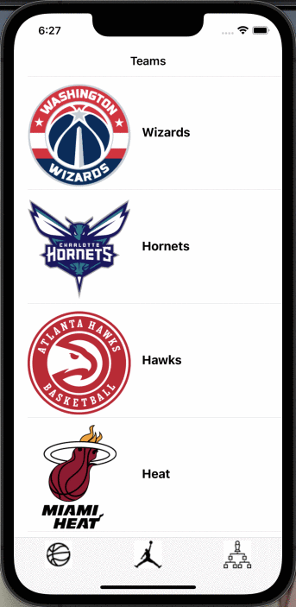
- Teams Screen
There are currently 30 teams in the NBA for the 2021-2022 season. The league is divided into two conferences, the Eastern Conference and the Western Conference. This app helps keep track of the schedules of users’ favorite teams’ games.
After users select their favorite teams, it immediately shows the results for the game schedules. They can check who is an opponent team for each game easily so that they never miss the games!

Slide 4
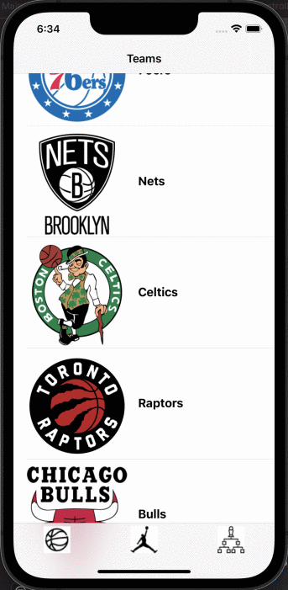
- Players Screen
About 540 NBA players registered in the current 2021-2022 season. It is hard to find each player’s information within the large number. Also, NBA players change each season. For sure users would like to keep up with their favorite players every new season.
This page helps to find each player’s information by their name. A user could type their favorite player’s name using the search bar and click the player. The user can find the player's picture, team, position, number, birth city, height, and weight.

Slide 5
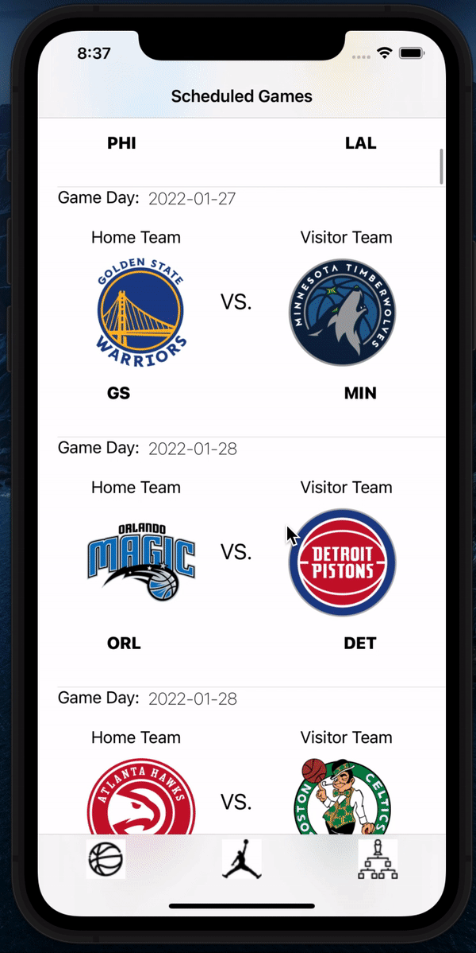
- Scheduled Games Screen
In the current 2021-2022 season, the NBA on ESPN is averaging 1,439,000 views per game. Our Scheduled Games screen helps the fan base keep track of what matches are coming up for today and the rest of the season. They will also be able to filter their results by entering a team’s code.
The sports data API, which demarks the status of each game as “Scheduled” or “Complete” allows the screen to continuously update and show the next scheduled game at all times.
NBA fans will never miss out on a game!

Slide 6

- Our Next Steps
NBA Stats was created for the millions of basketball fans worldwide. As such, future plans for the App include user-specific personalization:
A Favorites Home Screen, where each individual user will be able to see their favorite teams and players easily and faster
A Notification Screen, where users will be able to set their preferences for matches and be notified when they will happen.

